Slide 1

Coffee Cafe Night Marketing Insight
Subhajit Pal
June 2020

Slide 2
Agenda
Exploratory Analysis
1. Review the dataset and find key findings ,
2. Find trends in terms of consumer behavior over different times of the day and week.
3. Are there certain menu items that can be taken off the menu?
4. Are there trends across months , provide meaningful recommendation based on trend.
Menu Analysis
5. Introduce a combo meals in the menu to increase sale
6. Explore the possibility of launching a new Loyalty system

Slide 3
Key Findings
The dataset has been analysed in Tableau and excel. For more detail visualization , please refer to the below link :
Tableau Public link : https://public.tableau.com/profile/subhajit.pal6324#!/vizhome/CoffeeCafeNightAnalysis_SubhajitPal/TotalSales?publish=yes
1. The data set contains the sales data of Coffee Café Night for one full financial year( April 1st , 2010 to March 31 , 2011)
2.The dataset contains total 140500 rows of data , however if we summarize it by bill number , we have 44668 unique customer bill which amounts to total of INR 3.28 cr , so average monthly sales is 27.33 lacs
3. The dataset does not contain any customer information however it has all the details of all transactions and their timeline . Moreover there is no missing data .

Slide 4
Key Findings (contd)
Product Category
The café sells mainly below products :
1.Food and beverages
2. Alcoholic product – Beer and Wine
3. Tobacco and Hookah
4.MISC & Merchandise
So it is evident that Food and Tobacco are the most
selling categories and contribute to more than 90% of sales

Slide 5
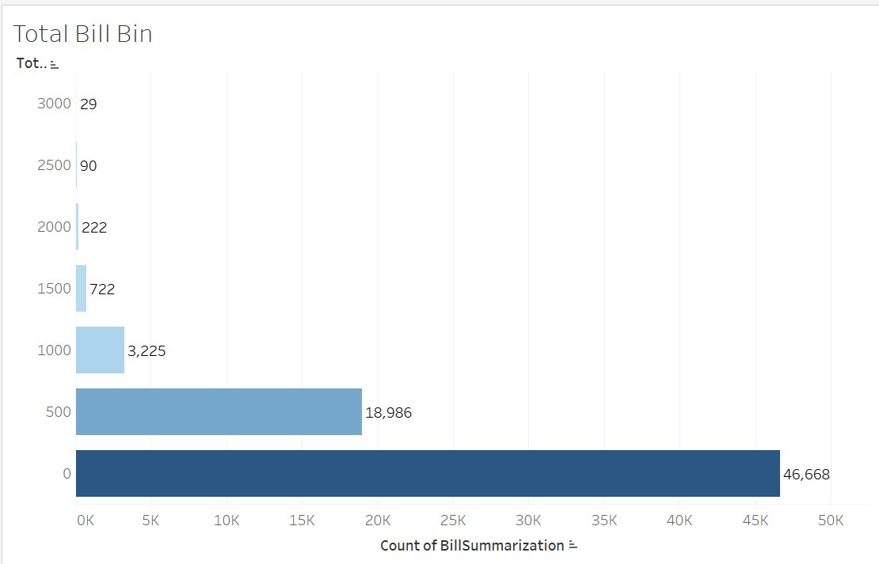
Key Findings- Bill Amount trend
1. The total bill amount of 500 or less forms the more than 42% of sales
2.Bill amount 500-1000 contributes to another 40% sales.
Recommendations:
The café should try to focus on customers who are spending 500 or less and they should encourage those customers to move over to next bracket of 500-1000. There is a huge potential to boost sales by this technique

Slide 6
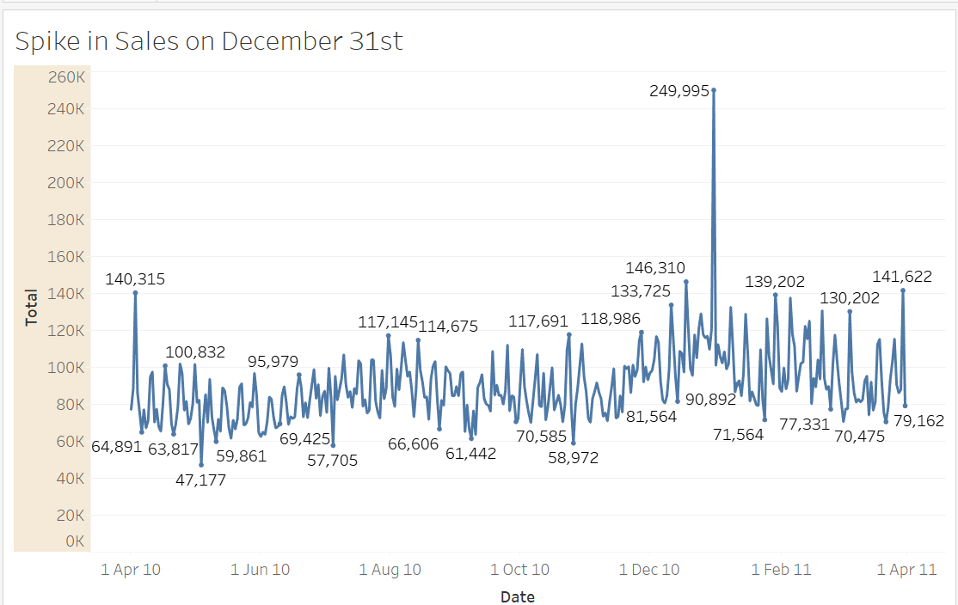
Key Findings- outliers
There is a huge spike in sales on December 31st .
Recommendation :
1. The café should prepare itself with all logistics for year end night
2. The café should hire more temporary labour for this night as it is a crucial day for creating a distinguished brand value.
3.On this day , only the top selling items should be in the menu so that turnaround time can be reduced , resulting in enhancing customer satisfaction

Slide 7
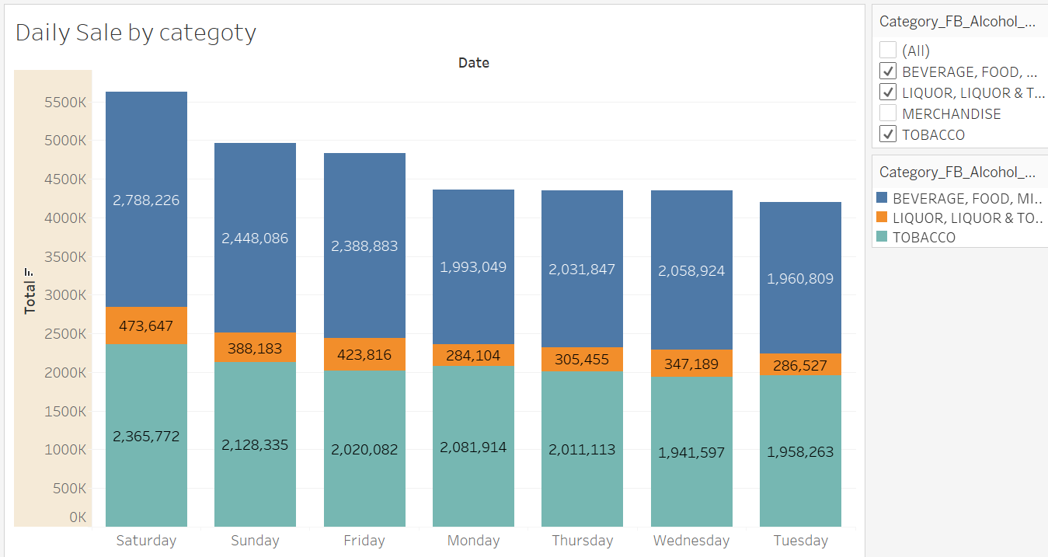
Trends over different days of the week
Since the sale of merchandise is negligible ,we focus only on F&B , alcohol and tobacco items .
The average sale is pretty consistent during Monday to Thursday and increase over the weekends .
While the sale of tobacco is consistent over the week , there is a huge rise in sales for F&B and alcohol on Saturday .
Recommendation : The café should introduce promotional event and offer more discounts during the weekdays on F&B and alcohols (only) to attract more crowds .

Slide 8
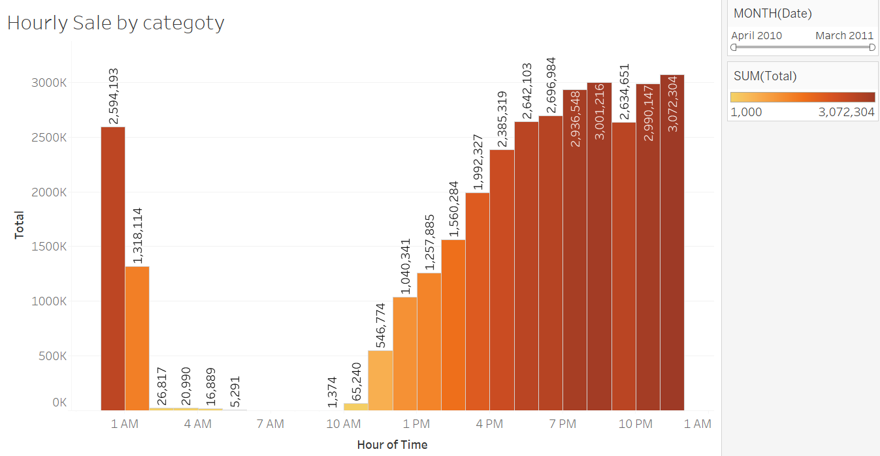
Trends over different times of the day
The store hours : 9 am to 6 am(next day )
The hourly sales chart over the year is displayed here.
The sale is very less from 2AM to 10 AM .
Also the sale of alcohol is very less during morning and afternoon hours
Recommendation :
1. Need to evaluate the operating cost during the late night and try to adjust the café timing . Keeping the café open late at night attracts lot of risk and labor cost is also high .
2. During the noon , offer more discount on beer to increase sales

Slide 9
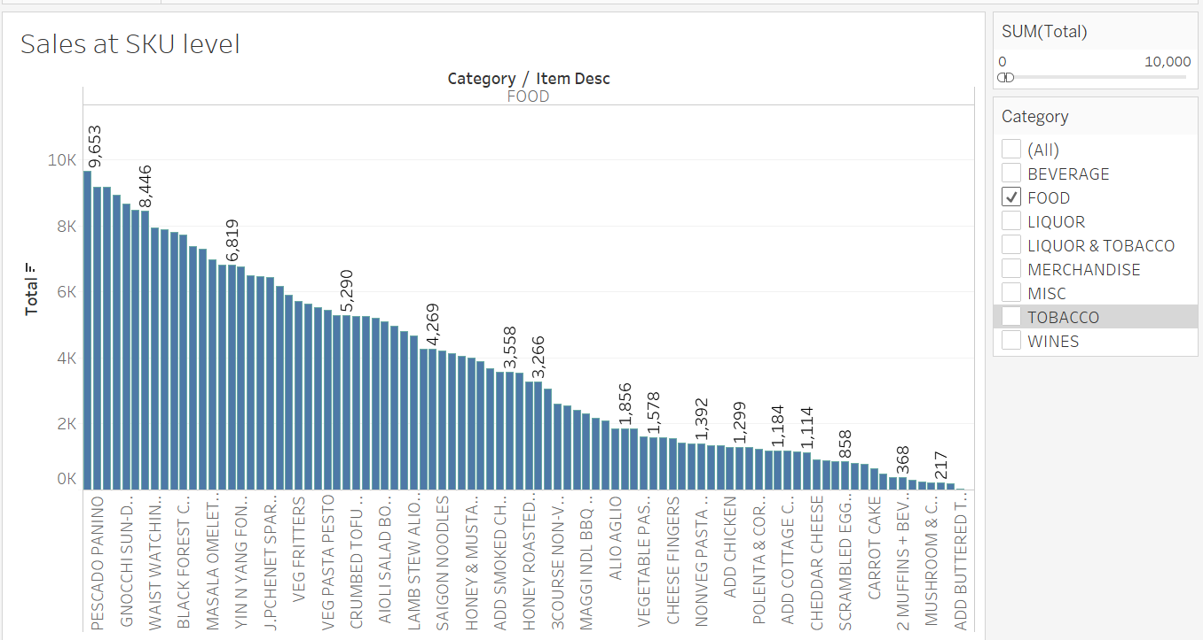
Remove items from the menu
We first analyse the SKU level total sales and try to find out the least selling items for each category
For food menu , if the total sales of an item over an year is less than 10k , we recommend to carefully consider them to remove from the menu .
These slow moving items cause procurement of related raw ingredients which often go waste
Removing these items will increase the operation efficiency of the café
We will also see the lease selling items in beverage and liquor segments .

Slide 10
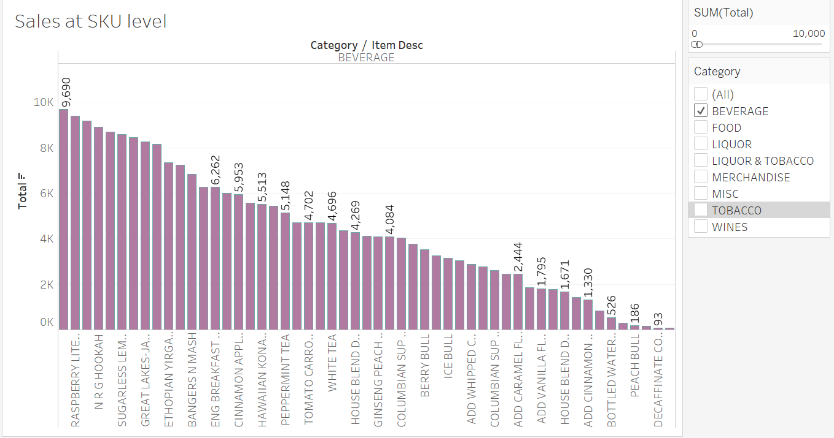
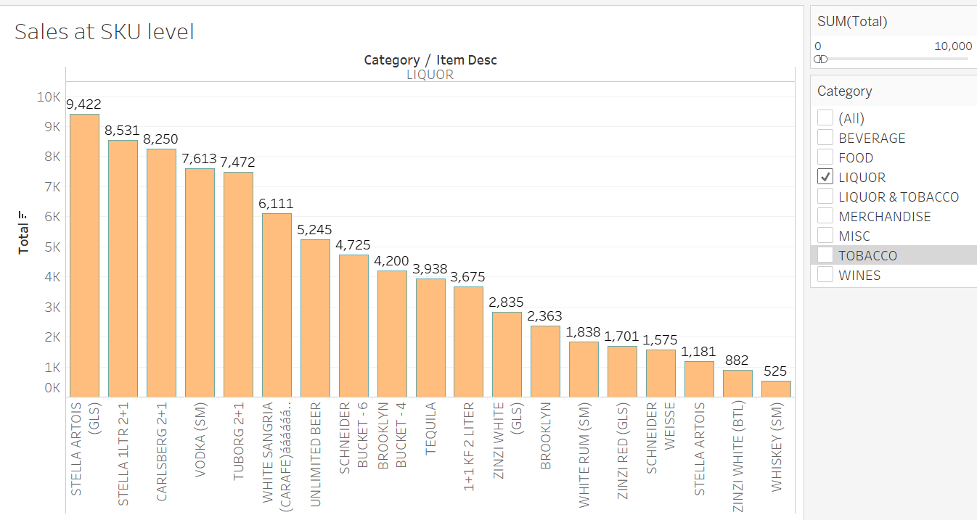
Remove items from the menu

Slide 11
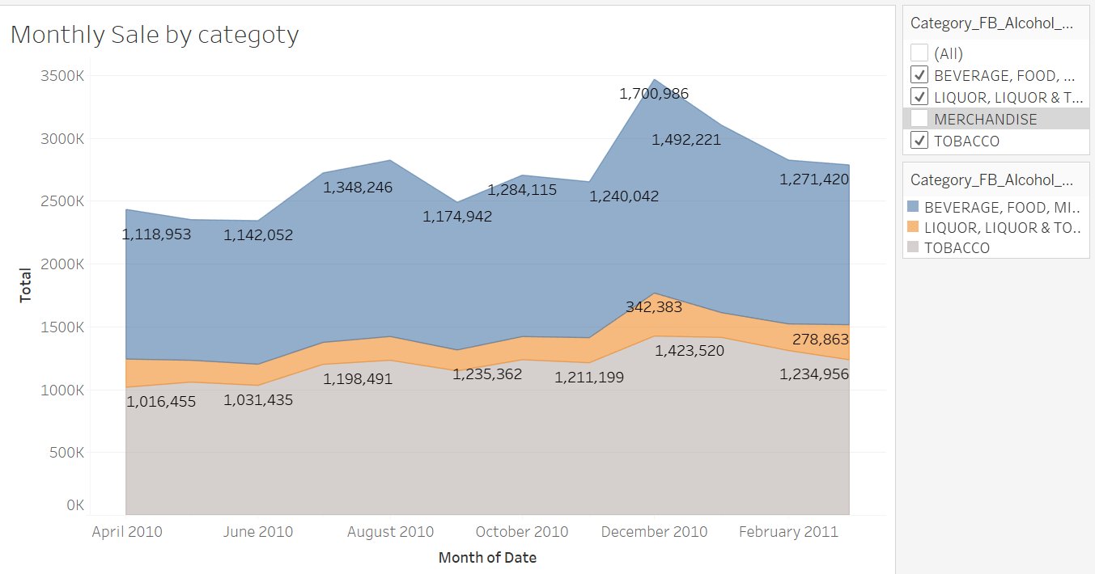
Trends over month
1. The overall sales in December is the highest , mostly due to the Christmas and year end /new year festival .
2. Also there is a periodicity the data set for each quarter .For every middle of the quarter, there is slight did in the sales
Recommendation :
The café should hold exciting events like live music or game show and offer goodies during the middle of each quarter .

Slide 12
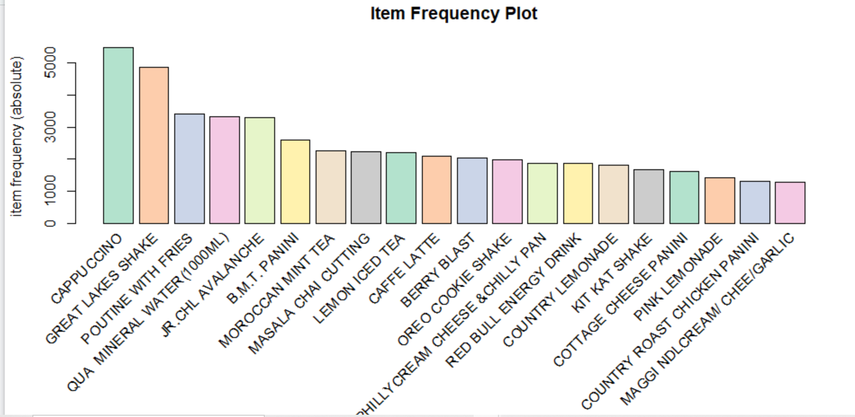
Menu Analysis
We have performed Market Basket analysis to have a better analytical view in the menu .
To start with we will only focus on sales of food and beverages.
Initial analysis show the list of top 20 selling items by frequency
Recommendation :
As we see Cappucino and Great Lakes Shakes are very fast moving items , if we wish to increase the sale of relatively slow moving items ( say Country Roast Chicken) , we should offer some combo meals with these 2 .

Slide 13
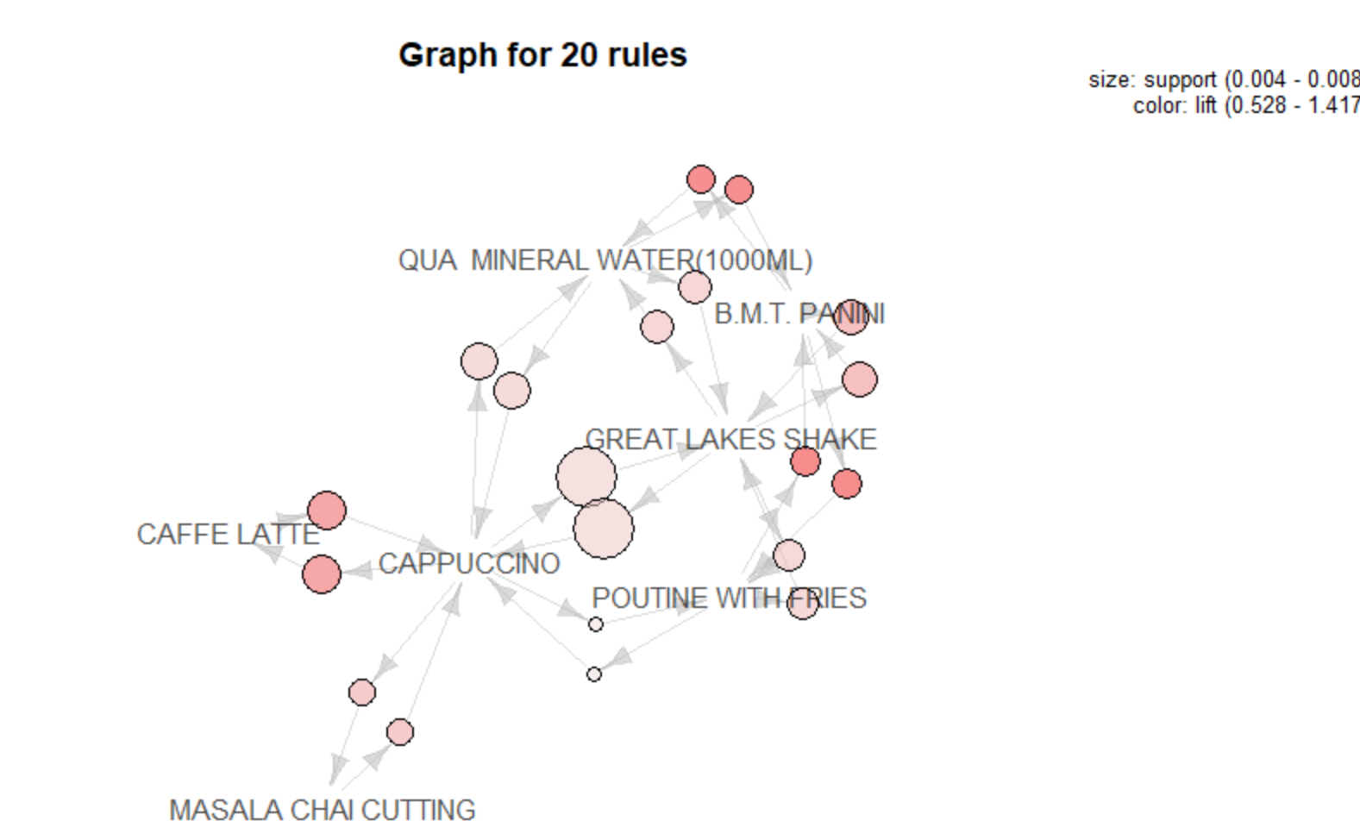
Market Basket Analysis – Food & Beverages
This graph gives a good understanding of top associations for some of the items.
We also have the complete set of rules , please refer to the attached data sheet .
Recommendation :
Select the rules with more lift and more confidence

Slide 14
Combo Recommendation
1.Based on high lift and high confidence , here is the list of top 50 rules.
2. Considering the list of top selling items and these association rules , we need to design few combo items to increase the overall sales.
3. We find the top 3 items (Cappacino , Great Lakes Shake and Avalanche) and match them with the suggested rules.
Please note , this is just a recommendation and need to be reviewed in each quarter. For example , during peak summer , more deals should be given on chilled beer and cold coffee/shakes rather than hot coffee

Slide 15
Combo Recommendation
1. Cappuccino : In café people mostly come in group and Cappacino is the top selling coffee. So there can be a combo pack of Cappuccino + Any 1 from the list ( Latte , Expresso, Doppio ) and a minimum discount ( say 10rs) can be offered .
2. Great Lakes Shakes : There should be a combo of other fast moving food items like Maggi /Panini with this Shakes
3. Poutine with Fries : Fries Combo should be offered with Maggi/Chicken Panni and Great Lakes Shakes
4. Similar combo can also be considered for Beer and hookah combo and Wine and hookah combo.

Slide 16
Customer Loyalty
1. It is important to build a customer loyalty program and the café should have the POS to collect the mobile number and email id for the customers.
2. Customer segmentation need to be done and targeted marketing over sms and mail id to run various promotion should be carried away .
3. The café should also introduce a survey option and for each deatil survey , they can offer a free cappuccino withing the 15 days time from the survey submission .
4. These will increase customer retention as well as frequency of regular customers.

